Slide 1

Machine Learning Pipelines for Improving Retention: Privacy and Procedures
Eric Yang, Melaku Woube, Nena Beecham
ericyang mwoube nbeecham
@gwu.edu @gwu.edu @gwu.edu
Presentations Download: https://irp.gwu.edu/resources-0/

Slide 2
GW Office of IRP Trilogy Presentations: 2022 - 2023
Transforming IR with machine learning project: Planning, Strategy, Practice
Identifying students at risk using machine learning models in Python
Machine Learning Pipelines for Improving Retention: Privacy and Procedures
Office Analytical Strategy and Planning
Collaboration
Data Selection and Software Platform
Data Elements and Conversions
Model Specifications and Evaluations
Model Explainability and Visualizations
Model and data Review: machine learning procedure and life cycle
Data Privacy Issues, Interactions and Strategies
Lesson Learned
All three presentations can be download at https://irp.gwu.edu/resources-0

Slide 3

Project Background and Objective
Background:
IRP needed actual projects to engage into AI/Machine Learning.
EM needed to identify students at risk for early intervention to improve retention and graduation rates.
Objectives:
To develop machine-learning models on retention and academic performance,
To predict at risk students using academic, financial aid, and engagement features.
To collaborate with Office of Student Success for early intervention efforts in the proactive approach.

Slide 4
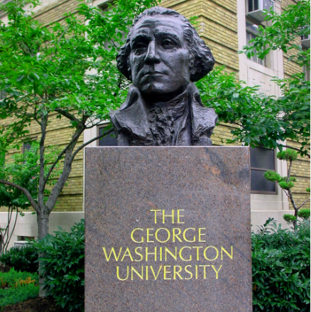
George Washington University Brief Background
(1821)
Private Research Doctoral University
- Very high research activity (R1)
Enrollment: 27,000+
Fall 2022 freshmen: 2,930
Six-year graduation rates: 82-85%
First - second fall retention rates: 90-92%
First - third fall retention rates: 85-86%

Slide 5
In this presentation
Machine learning project life cycle
Two years after we have worked on this project, what did we learn about the data and models.
How our focus changed from social engagement to academic engagement.
How data privacy issues came into play and impact our work
Lesson learned and further possible areas of studies

Slide 6
Machine Learning Life Cycle
The ML lifecycle is a process with instructions and best practices to use across defined phases while developing a ML project. It adds clarity and structure to the process. The figure below shows the end-to-end machine learning lifecycle process.

Slide 7
Machine Learning Life Cycle Continued
  Goal/Planning: The planning phase involves assessing the scope, success metric, and feasibility of the ML application. Having a clear idea about the value to be gained by implementing the ML project.
  Data collection/processing: This step includes collecting data, data cleaning (inputting missing values, reducing the noise), and data processing (normalizing and scaling the data)
  Model Development: It consists of model building, training, tuning, evaluation, validation and selection.
  Model Deployment: After a model is trained, tuned, evaluated, and validated it can be deployed into production; then predictions and inferences can be made on new dataset. (saving methods: pickle, Joblib, JSON, TensorFlow save, and PyTorch).
  Monitoring and Maintenance: After deploying the model we need to constantly monitor and improve the system. Monitoring model metrics, hardware and software performance, and customer satisfaction.

Slide 8
Goals/Planning
Initial goal – to identify high risk student using machine learning algorithms
Updated goals – predicting retention and graduation rate, and other areas that need predictive modeling including admissions yield modeling.

Slide 9
Data Collection and Processing
What data would you need to answer your question?
What data have you got?
How many missing values and is there a pattern to them?
Can you actually get your hands on every variable you need to answer your question(s)? If not, do proxies exist?
Is the data consistent across systems?
Who are the experts on this data and can you get their time?
What features/variables do you include?
Exploring features/variables one at a time

Slide 10
Data Collection and Processing
Pre-college Profile:
Academic/ Demographics
Academic achievement and progress
Financial aid/Need
Academic Engagement
Others: University Programs/
Employment
Social Engagement

Slide 11
Several Academic Engagement Variables
How we utilize LMS (Blackboard) login data
How we use the faculty feedback data
How we use the DFWI data and the implication

Slide 12
Data Collection and Processing Continued…
Missing data imputation
Recoding features – Faculty feedback, Care referral, course grade (DFWZ). etc.
Data normalization
Collaborated with different divisions in the university – enrollment management, student affairs

Slide 13
Model Development
We built multiple models: classification model, regression model, among others
Hyperparameter tuning – to find the optimum value for each hyperparameter to improve the accuracy of the model
We focused on classification algorithms

Slide 14
Model Selection Phase
In model selection the process, besides model performance it is advisable to consider other concerns, such as how long the model takes to train or how easy it is to explain to project stakeholders.
We trained multiple different machine learning algorithms on our dataset (classification, regression, etc.)
Used confusion matrix to evaluate model performance
Cross-validation is used to get an accurate assessment of a model’s performance
Finally, the cross-validation results show higher accuracy rate for tree related algorithms

Slide 15
Model Deployment
Work in progress
Used Shapley values to identify the average expected marginal contribution of each feature.
Good short-term solution for sharing predictions - exported into Excel and shared the output to stakeholders

Slide 16
Why data privacy is an important issue in machine learning analytics
It relates to student privacy protection:
Predictive modeling goes beyond traditional statistical analysis, involving more engagement variables and large amount of data, which may include sensitive information such as health, financial, financial aid, personal preferences, location, and activities at certain times.
Breaches or unlawful use of such information can be harmful to students’ credit scores, life styles, financial activities, personal life.
As IR Professional, we have professional ethnics to follow.
AIR Statement of Ethical Principles: We protect privacy and maintain confidentiality when collecting, compiling, analyzing, and disseminating information.

Slide 17
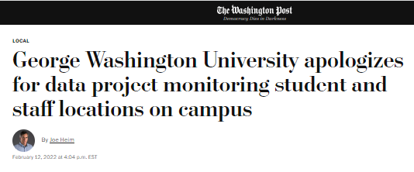
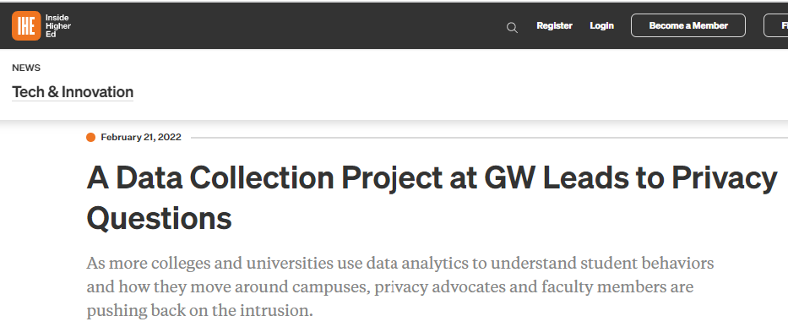
Why data privacy issue was particular focused at GW?
A wifi project incident: project used Wi-Fi location data across the campus on students, faculty and staff to determine density and use of buildings.
Identified and revealed by faculty members.
Form a committee to charge with establishing policy details governing the use of data for analytical purposes; and ensuring privacy policies and guidelines of the university are upheld

Slide 18
How we navigate the data privacy issues in doing machine learning project?
Beginning stage
Self-disciplined and followed the traditional IR data protocol and data governance procedure. Pay attention to health data, personal comments, and access to data.
Collaborating with Office of Privacy and Data Governance team after the wifi incidence
GW Privacy Office reviewed all analytical projects and determined their compliance status. We collaborated and reviewed all of our variables, and temporarily stopped using a few pending further review.
Data Privacy Consultative Committee was created to review polices and practice.

Slide 19

How we navigate the data privacy issues in doing machine learning project?
Modification of models and process to adapt to the GW environment
Update our mission statement to emphasize that we use data for analytics on student outcomes, and follow FERPA and GW privacy policy.
Collaborate with data governance to ensure the proper data access, especially for the model output.
Review our projects and data periodically to ensure compliance.

Slide 20
Lesson learned and recommendations on data privacy
Machine learning predictive modeling is still new. Need more communication with faculty and students.
Inspect the data elements in the following areas. Avoid using them if possible. If you have to use them, need to get approval. Further, get consensus from faculty and students.
Location data with time stamp, or login data with location/time
Wifi signal data including event data
Health data
Data governance and data access
Be careful with end result model output use and access.
Be careful with the labeling: at-risk model.
Notes:
if advisor work with students saying you are identified with risk (movie: Minority Report)

Slide 21
Overall Lesson learned on Project
Carefully document and categorize the data elements and modeling process
It is normally a year-long project, or longer!
It involves many variables from many areas and vendors, and needs data cleaning and conversion.
Machine learning projects are best to empower IR office analytics capability. Get your hand dirty with your data. Teamwork with your staff. Identify a project and start today!
Pay attention to data privacy and communicate with faculty and students.
Collaboration and support from the leadership.

Slide 22
Presentations Download: https://irp.gwu.edu/resources-0/

