Slide 1
Transforming IR with machine learning project: Planning, Strategy, Practice
Eric Yang, Melaku Woube, Nena Beecham
George Washington University

Slide 2
From George Washington University’s Journey on Machine Learning
Tuesday, June 7, 2 – 2:45pm
Wednesday, June 8, 3:15 – 4pm
Transforming IR with machine learning project: Planning, Strategy, Practice
Identifying students at risk using machine learning models in Python
Notes:
As we think it would be clearer to separate the modeling and data process from the planning and strategies, so we submitted our journey and practice into two proposals. Luckily both were accepted.
So tomorrow afternoon, three of us will have a session talked about the data elements and data processing, the features and targets, and modeling perspectives, and how we choose different models based on different scenarios, and how we use the Shapley values to help identify the student at risk and their areas of risk.
In today’s session, we focus more on the background of the project, the planning process throughout the project, and how to collaborate with other stakeholder offices to move it forward, what we learned from it as IR professional, how it helped IR office into more analytics, and what are lesson learned from the project. It is not very technical and it is not focused on machine learning modeling and data process, but provide an example for any IR office that would like to try to work on a machine learning project.

Slide 3
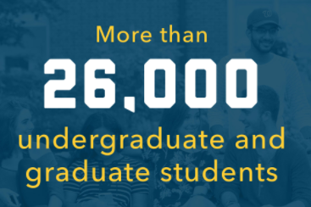
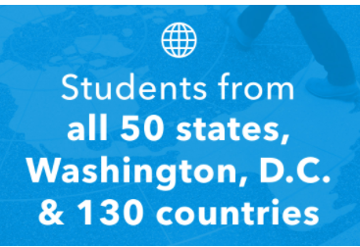
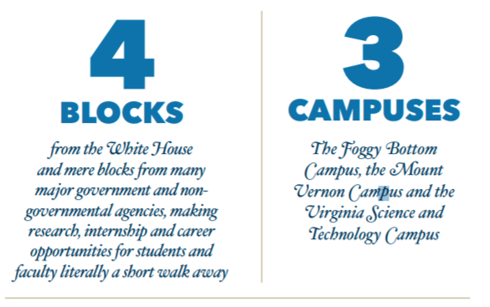
About GWU
Private research university: Doctoral Universities – Very high research activity

Slide 4
Background of IR and Related Offices
Enrollment and Student Success
Business Intelligence
Office of Institutional Research and Planning
Incorporate with student services.
Create committee on retention and graduation initiative implementation.
More focus on improving student success.
More centralized structure and report to finance area.
The process impacted on IT, schools’ data requests and visualizations, and committee structure.
Eager to move into data analytics
Less opportunity to work on BI and dashboard
Opportunity to work with EM on improving student success
Notes:
These two offices are also very related to the projects we are talking about. I assume in other institutions when IR office doing a ML projects, more than likely, you need to collaborate with these two offices.
The Enrollment Management division has certain structure changes in the past few years. My colleague, Melaku will provide more details in a moment. In addition to the tradition function such as admission, financial aid, and registrar, the change made the division more focus on improving the student success, by incorporating with several student services, and creating the correspond committees.
Also another office’s structure change has an impact on IR, which is the Business Intell. In the past, BI and Data Integration is one office which was reporting to IT. At that time, GW was very decentralized, every college had its own BI person, and the university had a BI steering committee which decide how to work on projects. With the restructure, BI reports to Finance, and Data integration stayed at IT, and all college and division BI persons being pulled into big BI team. So it doubled in size, and there is no BI steering committee, further, its focus is on the finance data and structure.

Slide 5
Background
Organizational Framework
Model Building and Implementation phases
Old Approach – Consulting Firm
New Approach – Internal Expertise
Opportunities and Challenges
Notes:
Institutions of higher education consist of complex structures that encompass broad decision-making systems and multiple power and authority structures that can be a challenge to implement retention and student success initiatives. Cognizant of the significance of institutional framework, GW created and charged ESS for student success initiatives

Slide 6
Organizational Framework
Establishment of the Office of Enrollment and Student Success (ESS), formerly Enrollment Management and Retention (EMR) - Office for Student Success, Office of Student Financial Assistance, Undergraduate Admissions, Center for Career Services, Strategic Enrollment Management, and Graduate Enrollment Management
Retention and graduation initiative implementation team
The Graduation, Retention, Advisory Committee (GRAD-C)
Notes:
This organizational structure created a great opportunity to identify and leverage collaboration among the units, most importantly, to ensure an outstanding student experience at GW.

Slide 7
Retention and Graduation Initiatives Implementation Committee
Staff members from IR, EMR, Student Affairs, Financial Aid, and Registrar
Prepared retention and graduation initiatives implementation plan
Recruited consulting firm
The firm was expected:
to develop a comprehensive retention data warehouse
and provide on-going analytic support including risk models
Notes:
ESS created this committee and move forward the retention and graduation initiatives

Slide 8
The Graduation, Retention, Advisory Committee (GRAD-C)
GRAD-C is a committee and working group that seeks to build capacity and partnership to support collaborative and data-informed responses that strengthen our collective efforts to improve the student experience. with a specific focus on undergraduate retention and graduation.
Replaced the earlier committee
It includes representatives from 9 divisions/units
Notes:
OSS created this committee a few months ago.

Slide 9
The Graduation, Retention, Advisory Committee Responsibilities
• Review student success analysis and reports
• Strategize on collaborative interventions
• Collaborate on process improvements to eliminate barriers,
recommend technological enhancements, etc.
• Collaborate on programming, student outreach and intervention and develop actionable responses to identified needs
• Identify cultural, systemic and/or policy barriers to student success to make recommendations to University leadership for improvements
• Share best practices and resources in student success

Slide 10
Model Building and Implementation
Notes:
The consulting firm relayed on traditional approaches, running logistic regression and decision tree using SPSS/SAS

Slide 11
Model Building and Implementation – Old Approach
Consulting firm built a database
In phase I, the firm started to provide risk roster for forthcoming first year class, thereby allowing GW to support at-risk students at the earliest possible.
In Phase II, the project was expected to produce risk models for graduation and retention at different levels, but the project did not progress as intended due to several reason including the firms lack of expertise in the machine learning environment.
Notes:
The consulting firm relayed on traditional approaches, running logistic regression and decision tree using SPSS/SAS

Slide 12
Model Building and Implementation – New Approach
Using internal expertise - OSS formed a team (a year ago) - IR and ESS staff
Using machine learning platforms
Revised and updated data collection and analysis plan
Data collection and formatting to fit supervised ML algorithms
Conduct bi-weekly meeting; reaching out to BI team to inquire about model automation in the server and consulting with a data science faculty.

Slide 13
New Approach: Data Collection for Risk Modeling
Started building a database for risk modeling - drawing a wide range of transactional data on diverse aspects of the undergraduate experience as maintained in 8 departments/divisions of the University
Office
Registrar
Admissions
Data Source
Banner
Banner, Common App, CRM
Attributes
Academics
Demographics

Slide 14
Data Collection for Risk Modeling - Continued
Office
Career Services
Financial Assistance
Data Source
Handshake
Banner
Attributes
Employment & Internship
Grants, loans, indebtedness
RMS, Engage, Maxient
Housing, student org, Care visit
Student Affairs

Slide 15
Data Collection for Risk Modeling - Continued
Office
Division of Libraries
Division of Safety & Security
Data Source
Blackboard
GWorld
Attributes
Blackboard login, faculty feedback
Logins indicators
Connection and Check-in Surveys
Wellbeing, engagement, connection, academic, plan
OSS

Slide 16
Opportunities and Challenges
Opportunities
Building collaboration among different offices
Leaning about different systems that store students data
Learning more about ML platform
Challenges
Wanted to build a database for ten cohorts
Not all data sources have ten years worth of data
Incomplete dataset (e.g. faculty feedback)
The impact of data security/privacy policies

Slide 17
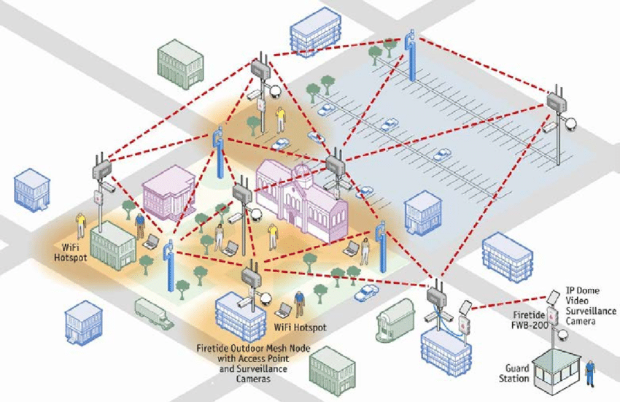
GW Data Analytics Incident and Impact on Our Project
Background:
Incident about data-analytics pilot project.
The project used Wi-Fi location data across the campus on students, faculty and staff to determine density and use of buildings in the aggregate.
Not completely anonymized -The data is de-identified, but the descriptors, such as gender, were attached to the data for analysis.
A committee formed - charged with establishing policy details governing the use of data for analytical purposes; and establishing protocols to ensure that the privacy policies and guidelines of the university are upheld
Notes:
This project was implemented with third party vendor through Cisco.
The story is published on Inside Higher Education, Washington Post, and GW Hatcher (student newspaper). It was first revealed by the GW President by his email sending to the GW community. However, there were many things not answered clearly.

Slide 18
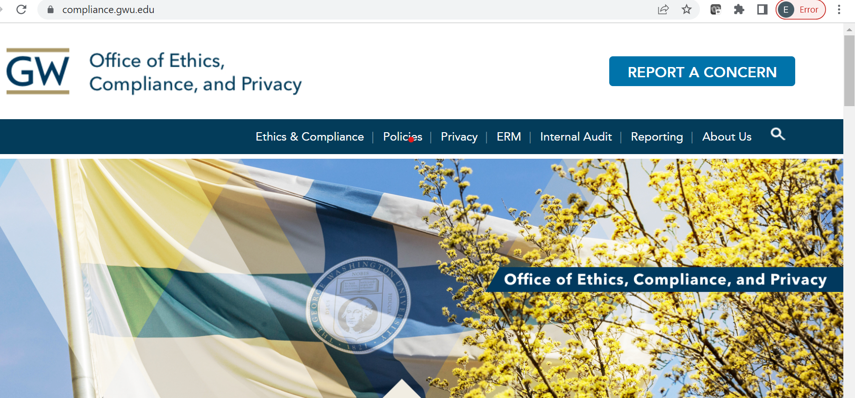
GW Data Analytics Incident and Impact on Our Project
Because of this incident, the Office of Privacy and Securities reviewed all analytical projects and determined their compliance status. The review impacted our project as well.
Specifically, the following two variables will not be used:
Blackboard login, which is actually very significant predictor.
Access to Library: The initial result with this predictor is mixed, as not all undergraduate students used library on regular basis.

Slide 19
Planning: Implementation of Machine Learning
This Photo by Unknown Author is licensed under CC BY
This Photo by Unknown Author is licensed under CC BY-ND
This Photo by Unknown Author is licensed under CC BY
This Photo by Unknown Author is licensed under CC BY-SA
Determining Scope of Data
Statistics Versus Machine Learning
Approaching Machine Learning
Choosing a Programming Language
Understand what type of data is available to you
Select indicators that can be improved
Statistical concepts in machine learning
Exploratory data analysis
Exploration of resources
Determining project approach
Python, R, Java, C++, Java, JavaScript, WEKA
Benefits of Python Programming

Slide 20
Exploratory Data Analysis
Accurate data needed for model training
What data is available to us?
Collaborate across university departments for additional data
Document data inventory of current department
Purpose of model is to identify students at-risk > select indicators that we can improve
GPA
Student organization membership
What is the current state of this data?
Data cleaning
Timespan, Frequency of updates
Class Distribution
This Photo by Unknown Author is licensed under CC BY-ND

Slide 21
Statistics Versus Machine Learning
Machine Learning: Subfield of artificial intelligence
Goal: uses algorithms to learn and improve from experience
Usage: make repeatable predictions by finding patterns within data
Interpretability: models developed can be extremely accurate but difficult to understand
Statistics: Subfield of mathematics
Goal: data collection, organization, analysis, interpretation and presentation.
Usage: make an inference about a population based on a sample (inferential statistics)
Interpretability: typically easier to understand > the accuracy of relationships is supported by tests of statistical significance
This Photo by Unknown Author is licensed under CC BY-NC
This Photo by Unknown Author is licensed under CC BY-SA-NC

Slide 22
How can we use Machine Learning?
What am I able to do with machine learning?
How have projects like mine been approached?
Online Resources
Kaggle, GitHub, DataCamp, TowardsDataScience, MachineLearningMastery
Print Resources
Data Mining: Practical Machine Learning Tools and Techniques
O’Reilly for Higher Education
University Library Resources
This Photo by Unknown Author is licensed under CC BY-SA
This Photo by Unknown Author is licensed under CC BY

Slide 23
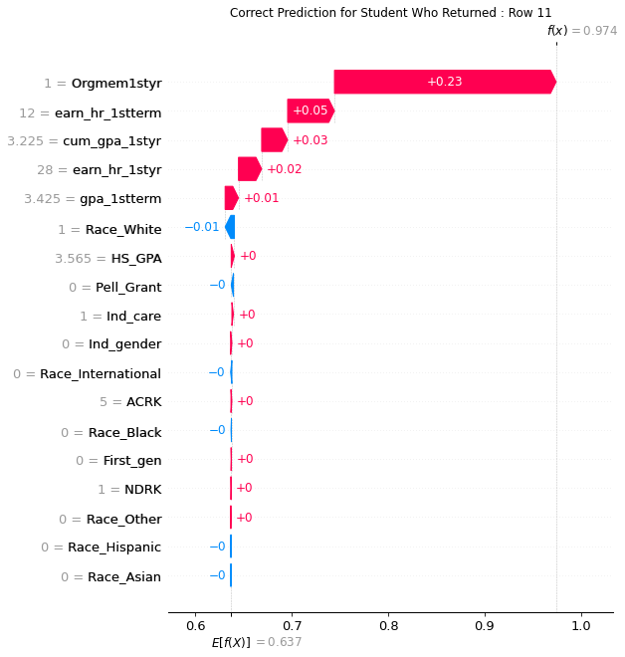
How can we use Machine Learning?
Faculty Consultation
Data science, Computer science
Considerations for imbalanced datasets
Choosing a good evaluation metric
Model suggestions (XGBoost)
How can we identify which variables help students retain?
SHAP Library > Python programming package
Based on game theory

Slide 24
Benefits of Python Programming
Free and open source
Extensive variety of libraries for all purposes (machine learning, data cleaning, data visualization)
Platform independence (works across Windows, macOS, Linux)
Popular programming language and large community (good documentation and online support)
Skills are transferable > IR to Data Science
This Photo by Unknown Author is licensed under CC BY-SA

Slide 25
Proficiency in Machine Learning from IR perspective
For most IR practitioners, it is more about understanding the difference from statistics, and reviewing data and modeling from new perspective.
There are resources always available online, and through faculty.
There is a limit we spend time and energy on it: we are machine learning practitioner using higher education data, not a machine learning researcher.
Notes:
We are not prepare to become a top data scientist, our goal is ML practitioner in HE field. We know the HE data better than other top data scientists in the industry.
Once the ML models are set up and moving, we could make it work on retention model, on graduation model, on admission summer melt model, on course DFIW model, on major shift models, with different datasets. Our strength is know better about the HE data, it is more like we have used regression, ANOVA and logistic regression models in the past 20 years, now, we are equipped with new set of ML models and mentality, and new scope of data, and we can work on those datasets to get new findings.

Slide 26
Lesson Learned Through the Project as IR Leader
Machine learning project is a good way to raise the IR office data analytics power. The best way to learn machine learning is to implement an actual project from start to finish.
Get your hand dirty with your data.
Teamwork with your staff.
Collaboration and Support from the leadership.
Schedule bi-weekly meetings with your stakeholders.
Notes:
You might think you are in IR for 20 years. However, with the new era of so many different types of data from different offices, you cannot just wait for your analysts to feed you with clean data to get into your model. You can only find the myth by clean the data yourself. In fact, your 20 years of experience with HE may help you get more things from the data, and then let your young staff to work on the modern, advanced modeling, would be a better combination.
The model refinement has limits in improvement. Finally one has to go for more data cleaning and more data source. You have to go more into the data, clean the data, work with other offices to get more data about the students

