Slide 1
Identifying students at risk using machine learning models in Python
Eric Yang, Melaku Woube, Nena Beecham
George Washington University
Notes:
Hi everyone, welcome to our session.
In this session, we will talk about the project we have done at George Washington University, which used machine learning model using python to identify student at risk of drop out and can not graduate.
Here we have a team of three from George Washington University. I am Eric Yang, Director of Institutional Analytics. Two of my colleagues are Melaku Woube and Nena Beecham.

Slide 2
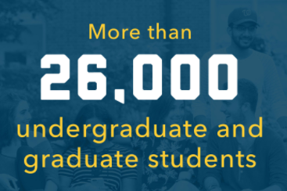
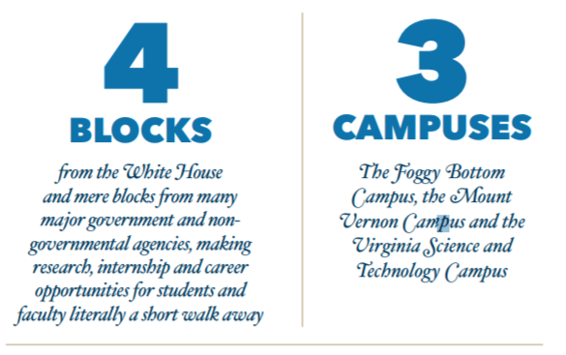
About GWU
Private research university: Doctoral Universities – Very high research activity
Notes:
First let me introduce my institution. George Washington University is in the center of nation’s Capital, it was envisioned and built 200 years ago through our founding father’s last will and testament.
Geographically, its main campus of Foggy Bottom, is only four blocks away from the White House. Such a short distance to many federal and international agencies provides many internship and career opportunities for students. It has another campus in George Washington’s Mount Vernon Estate, and the third campus in Virgina.
Today, it has become a world-class private research university with very high research activity. Its 26,000 students come from all 50 states and 130 countries, they study in 10 schools and colleges, including medical school, Law school, school of nursing and school of health science.

Slide 3
Project Background
GW’s IRP office has been working on traditional IR duty, and needs a project to engage into AI/Machine Learning.
Enrollment Management Office of Student Success worked with a third-party vendor on identifying student at risk for early intervention, but not successful.
IR office has been working closely with EM and likes to take this project to improve its data analytics power.
Notes:
IRP: IPEDS, reputation surveys, ad-hoc, we also build some dashboards, occasionally we do some stat analysis on student retention and on faculty salary equity using SAS and SPSS. But that is basically it. You can do it until you retire. Steve Job: do you want to sell sugar water for the rest of your life?
Outside world, people talk about artificial intel, ML, big data, data lake, cloud. We attend many sessions, we know many concepts. There are available on internet. Still, we need an actual project to learn these concepts and learn how to put them into practice. What you learned from textbook is different from what you learned from work.

Slide 4
Project Objectives
To develop multiple machine-learning models on retention and academic performance, and able to predict the students at risk at individual level, using features in categories of academic, financial aid, and engagement.
Focus and investigate certain cohorts with low retention rates, and collaborate with Office of Student Success for early intervention efforts in the proactive approach.
Models will be built and tested in the desktop Python environment. The final product will use data warehouse running on a Python server.

Slide 5
Challenges in the Project
Understand machine learning models, big data and gain access to the data.
Mindset change from statistics to machine learning
Risk in working on this project: many uncertain factors could lead to failures.
Collaborations and support
Notes:
Risk: Internally, we call this the risk model project. Right, it is a risk project. So far, we still not sure if it could be successful. For example, remember that our final goal is to run the model in Python server using the data warehouse data. We had one meeting with IT on Python installation, they showed us many technical aspects, that made me headache. Finally I asked them, there are so many faculty, and data scientists at GW, anyone asked you to install python server yet? The answer is no.

Slide 6
In This Session . . .
Regarding the collaborations, strategies and how we were working on the plan to execute this project, we discussed more in our yesterday’s session:
Transforming IR with machine learning project: Planning, Strategy, Practice
In today’s session, we are more focused on the data elements, modeling perspective and technical.

Slide 7
Data For the Modeling - Categories
Pre-college (Academic/ Demographics) Profile
Academic achievement and progress at GW
Institutional programs
Engagement (academic and social)
Employment
Financial Need
Notes:
Empirical and theoretical retention framework established by Bean, 1980; Braxton,2000; Chapman and Pascarella, 1983; Pascarell and Ternzini, 1978; St. John and Cabrera, 2000; Tinto, 1975, among others are used to determine major categories and guide for model variable selections.

Slide 8
Data for the Modeling Details
Pre-college (Academic/ Demographics) Profile
Demographics, parental education, first generation, legacy, international/domestic, high school background, ALEKS, test optional, ACRK
Banner, Common App, ALEKS
Academic achievement and progress at GW
Academic performance indicators, withdrawals, academic standing, school, major, major change, school change, term major declared, transcript request, enrollment in special and high impact programs
Banner
Institutional programs
Coaching, summer academy, study abroad, mentoring, first year seminar, CARE center visit
OSS, Banner, Student Affairs, Temperature survey, connection survey

Slide 9
Data for the Modeling Details Continued
Engagement (academic and social)
Student org membership, Dormitory, living-learning community, blackboard login, use of learning center, tutorials and faculty office hours, establishment of friendship
Engage, Banner, Blackboard, Temperature Survey, Connection survey, Check-in survey, Gworld
Employment
Internship, federal work study, non-FWS wage account employment
Banner, Handshake
Financial Need
Loan, EFC, Gross Need, unmet need, merit and need awards, Pell flag, NDRK
Banner

Slide 10
Data Preparations and Cleaning
Examining the availability of data on all attributes/variables for all cohorts
Ensuring data collection and utilization confirm GW’s data security/privacy policy
Pulling data from several systems; Creating flags , recoding attributes/variables and align them with retention and graduation cohorts

Slide 11
Steps to Risk Modeling Project
Model Selection
Model Evaluation
Model Explainability
How do I know which model to choose?
How do you evaluate the predictions of your model?
How will my model perform on new, unseen data?
How do I improve the performance of my model?
Why did my model make the predictions it made?
Explainable AI

Slide 12
Part 1: Model Selection
How do I know which model to choose?

Slide 13
Selected Models for Risk Modeling
Random Forest Model
XGBoost Model
This Photo by Unknown Author is licensed under CC BY
This Photo by Unknown Author is licensed under CC BY-NC

Slide 14
Part 2: Model Evaluation
How do you evaluate the predictions of your model?
How will my model perform on new, unseen data?
How do I improve the performance of my model?

Slide 15
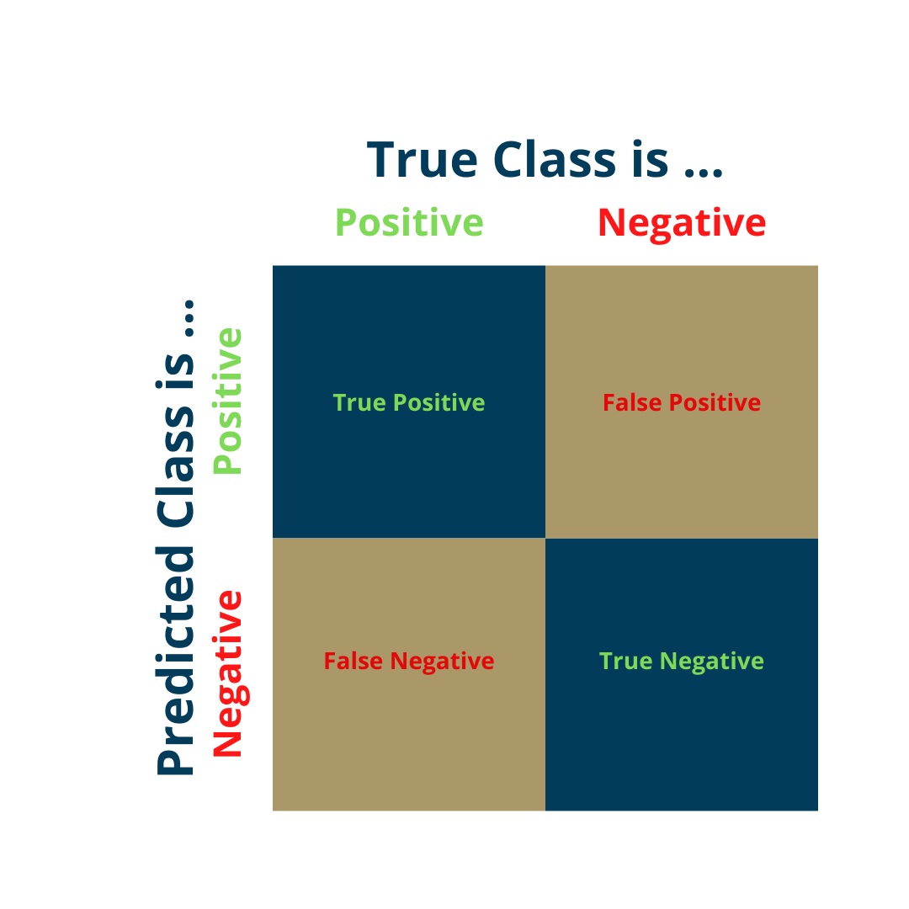
Model Evaluation: Confusion Matrix

Slide 16
Confusion Matrix-Based Evaluation Metrics
Accuracy metric not sufficient in measuring the performance of a model with class imbalance
Appropriate evaluation metric will depend on severity of implications for false predictions

Slide 17
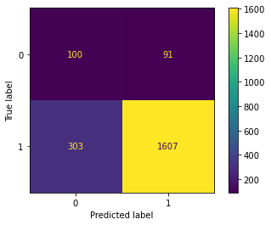
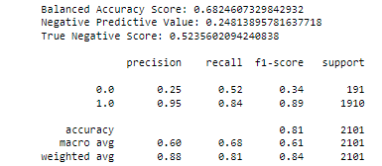
Our Model: Classification Report and Confusion Matrix
Correctly predicted 100 of the 191 students who dropped out (52%)
Correctly predicted 1607 of the 1910 students who were retained (84%)
Focus on increasing true negative rate and decreasing false positive rate

Slide 18
How will my model perform on additional unseen data?
Depending on your project, it may be difficult to access new data
Cross-validation provides a more accurate assessment of model performance on new, unseen data
KFold, Repeated KFold, Stratified KFold, Nested
This Photo by Unknown Author is licensed under CC BY-NC

Slide 19
Results of Stratified Cross-Validation
Results of Stratified Cross-Validation on Original Random Forest Model
Average Balanced Accuracy Score | 0.62
Average Negative Predictive Value | 0.24
Average True Negative Score | 0.36
Average Weighted Recall Score | 0.84
Average Weighted F1 Score | 0.85
Chose stratified k-fold cross-validation to replicate distribution of dataset for each training fold
Revealed slightly higher weighted recall and F1 scores
Revealed slightly lower balanced accuracy, negative predictive value, and true negative scores

Slide 20
How do you improve your model’s performance?
Each model has parameters that can be modified
Hyperparameter tuning is the process of finding the optimum value for each parameter to improve the accuracy of the model
Two most popular hyperparameter tuning techniques are Grid Search and Randomized Search
Grid Search: More exhaustive
Randomized Search: more appropriate when you have many parameters and a large dataset

Slide 21
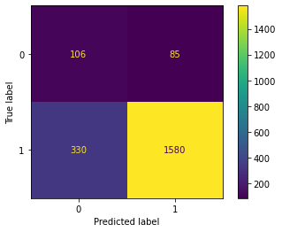
Randomized Search Results
Comparison of Original Model and Tuned Model
Metric | Original | Tuned
Average Balanced Accuracy Score | 0.62 | 0.63
Average Negative Predictive Value | 0.24 | 0.22
Average True Negative Score | 0.36 | 0.42
Average Weighted Recall Score | 0.84 | 0.81
Average Weighted F1 | 0.85 | 0.83
Correctly predicted 106 of the 191 students who dropped out (55%)
Randomized Search helped increase true negative score by 16%
Balanced Accuracy slightly increased as well
Negative predictive value, weighted recall, and weighted F1 slightly decreased
Scoring method indicated in hyperparameter tuning should be metric you want to improve

Slide 22
Part 3: Model Explainability
Why did my model make the predictions that it made?

Slide 23
Explainable AI: SHAP Library
Explainable AI > emerging field aiming to provide insights into “black box” decisions of machine learning algorithms
Which variables are most useful in identifying at-risk students?
This Photo by Unknown Author is licensed under CC BY-SA-NC

Slide 24
Explainable AI: SHAP Library
SHAP library > Python package used to explain the predictions for machine learning models
Based on Game Theory
SHAP values > help us quantify a feature's contribution towards a prediction
Allows us to view which features and feature values influenced predictions for individual students retaining
Helps us identify in which direction (ex. positively or negatively) they influence predictions for student retention

Slide 25
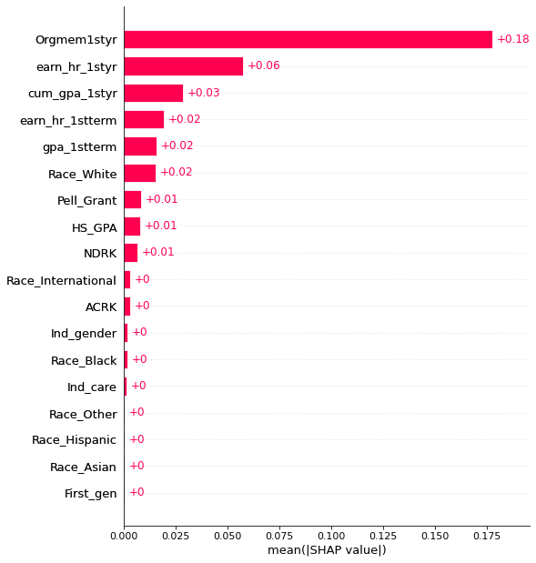
Example: Global Bar Plot
Across the entire dataset, student organization membership had the largest influence on student retention predictions
Features near the bottom do not have much of an influence on the model
Expected value > 0.637
Average probability of student retaining across the training set

Slide 26
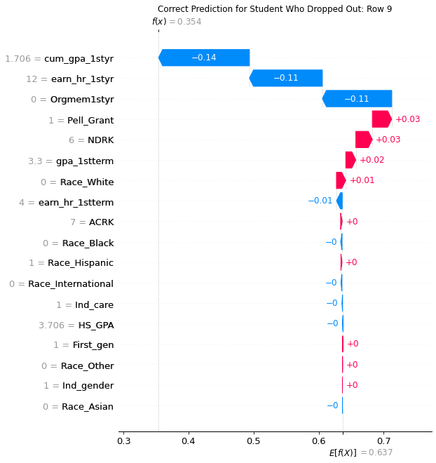
Example: Individual Prediction for Student Who Dropped Out
f(x) = 0.354 > Model’s prediction for this student retaining
Red > increased the probability of retaining
Blue > decreased the probability of retaining
Largest factors in dropping out:
1.706 first-year GPA
12 hours earned the first year
No student organization membership

Slide 27
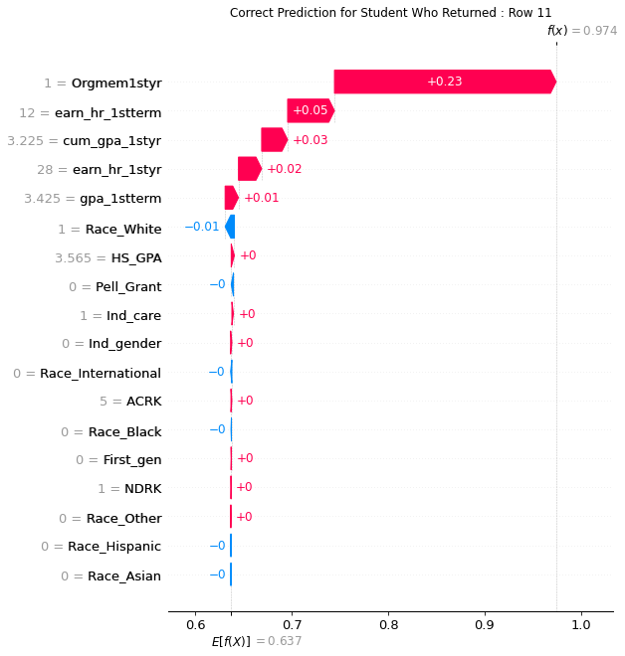
Example: Individual Prediction for Student Who Was Retained
f(x) = 0.974 > Model’s prediction for this student retaining
Red > increased the probability of retaining
Blue > decreased the probability of retaining
Largest factors in retaining:
Student organization membership
12 hours earned first semester
3.225 first-year GPA

Slide 28
Lessons Learned
This Photo by Unknown Author is licensed under CC BY-NC
This Photo by Unknown Author is licensed under CC BY-SA-NC
Heed considerations for imbalanced dataset
Document and Protect Your Source Code
Model Improvement is a Journey
Success of model determined by evaluation metric
Keep notes for each step of the project
Save source code as separate modules or read-only files
Model may change as new data becomes available

Slide 30
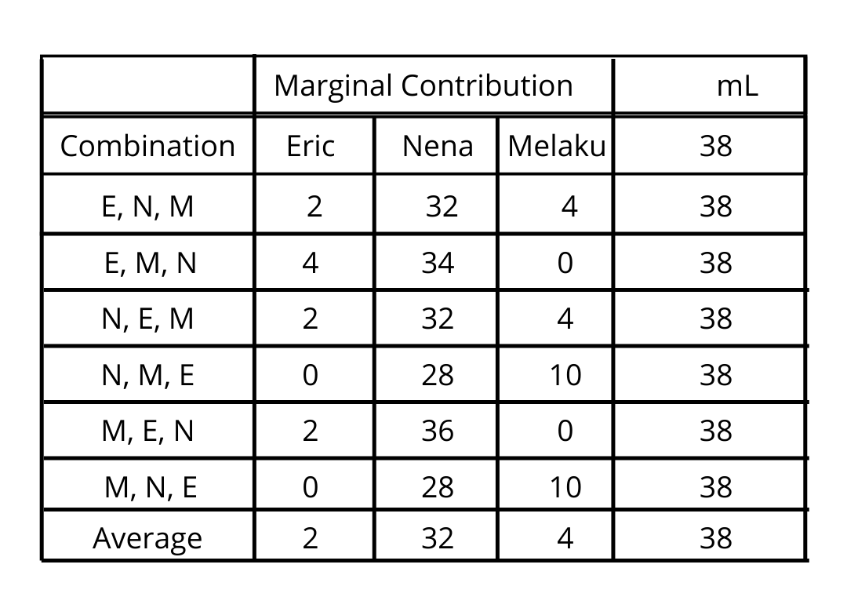
Appendix: SHAP Value Calculations
The SHAP value is the average marginal contribution of a feature value to the prediction in different coalitions.
The SHAP value is NOT the difference in prediction when we would remove the feature from the model.
SHAP values calculate the importance of a feature by comparing what a model predicts with and without the feature.
However, since the order in which a model sees features can affect its predictions, this is done in every possible order, so that the features are fairly compared > Multiple permutations
SHAP requires to train a distinct predictive model for each of these distinct permutations.
Expected Value: 30 mL

